Slide 1
SWAG LABS WEBSITE TEST AUTOMATION PROJECT
SOFTWARE TESTING TRACK- DIGITAL EGYPT PIONEERS INITIATIVE

Slide 2
Team Members
Supervisor
Rana Reda
Nada Disouky
Rewaa Hany
Mohamed Moustafa
Eng. Ahmed Abass

Slide 3
Index
What Is Test Automation
Why Use Automated Testing
Brief About SWAG Labs
Test Automation Process
Tools Used
Selenium Test Scripts
Automation Test Suites
The Demo
GitHub Repo
Conclusion
Reference

Slide 4
What Is Test Automation
Test automation is the process of automatically running tests, managing test data, and using the results to improve software quality. It replaces repetitive manual testing with efficient, reliable automation.

Slide 5
Why use automated testing
Why we prefer automation over manual in many cases:
More Testing, Less Effort: Automation lets you test more in less time and with fewer people.
24/7 Testing: Automated tests run any time—even when your team is offline.
Faster Delivery: Speeds up feature releases by reducing regression testing time.
Smoother Releases: Automated tests can run during development, catching bugs early.
Better Resource Use: Saves time for testers to focus on more complex, creative tasks.

Slide 6
Brief About SWAG Labs
Swag Labs is a demo e-commerce website used for testing and showcasing automation. It provides various functionalities, such as login, product filtering, adding items to the cart, and completing a purchase.
In our project, we:
Used manual testing and Selenium WebDriver to test main features.
Created test cases for basic user actions like login and adding items to the cart.
Followed a basic automation framework (no APIs used).

Slide 7
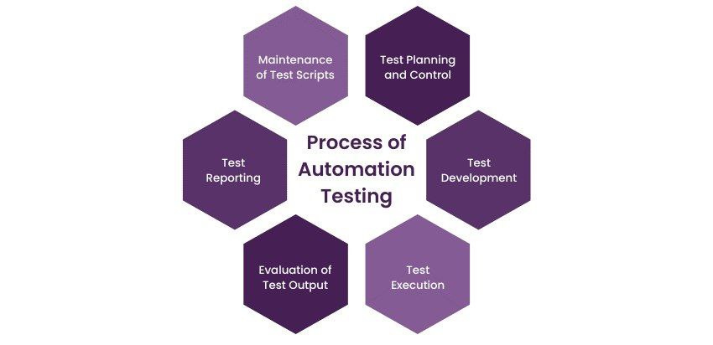
Test Automation Process

Slide 8
Tools Used
1. Selenium WebDriver
– Used to automate browser actions and simulate user interactions with the Swag Labs website.
2. Java
– The programming language used to write the automation test scripts.
3. IntelliJ IDEA
– IDE (Integrated Development Environment) used for writing and running the automation code.

Slide 9
Tools Used
4. GitHub
– Used to store and share the project source code.
5. Google Sheets
– Used to design and organize manual and automated test cases.

Slide 10
Automation Test Suites
User Invalid Login
Add To Cart

Slide 11
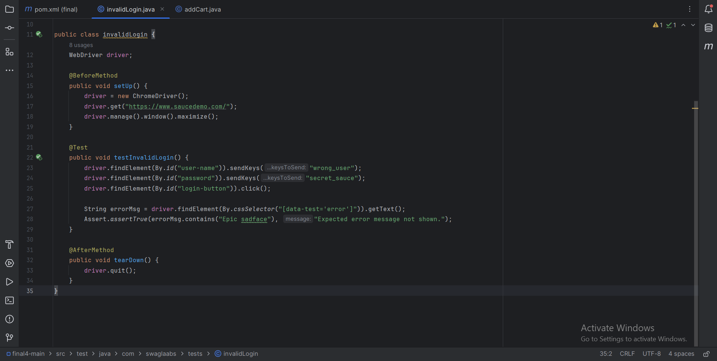
Selenium test scripts

Slide 12
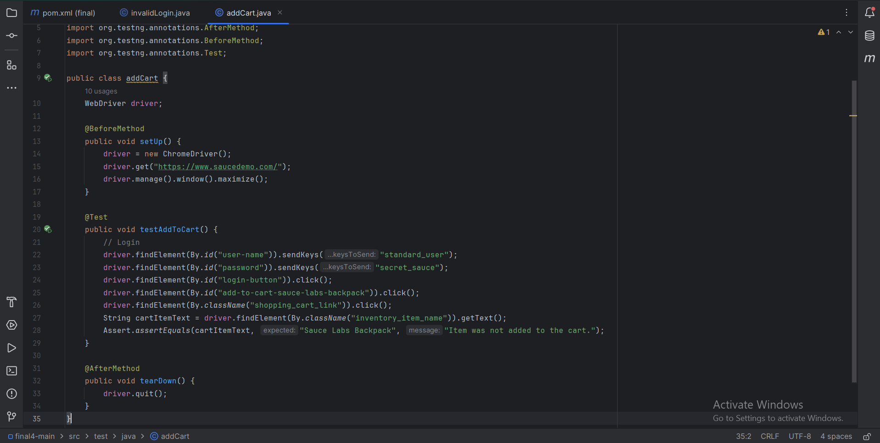
Selenium test scripts

Slide 13
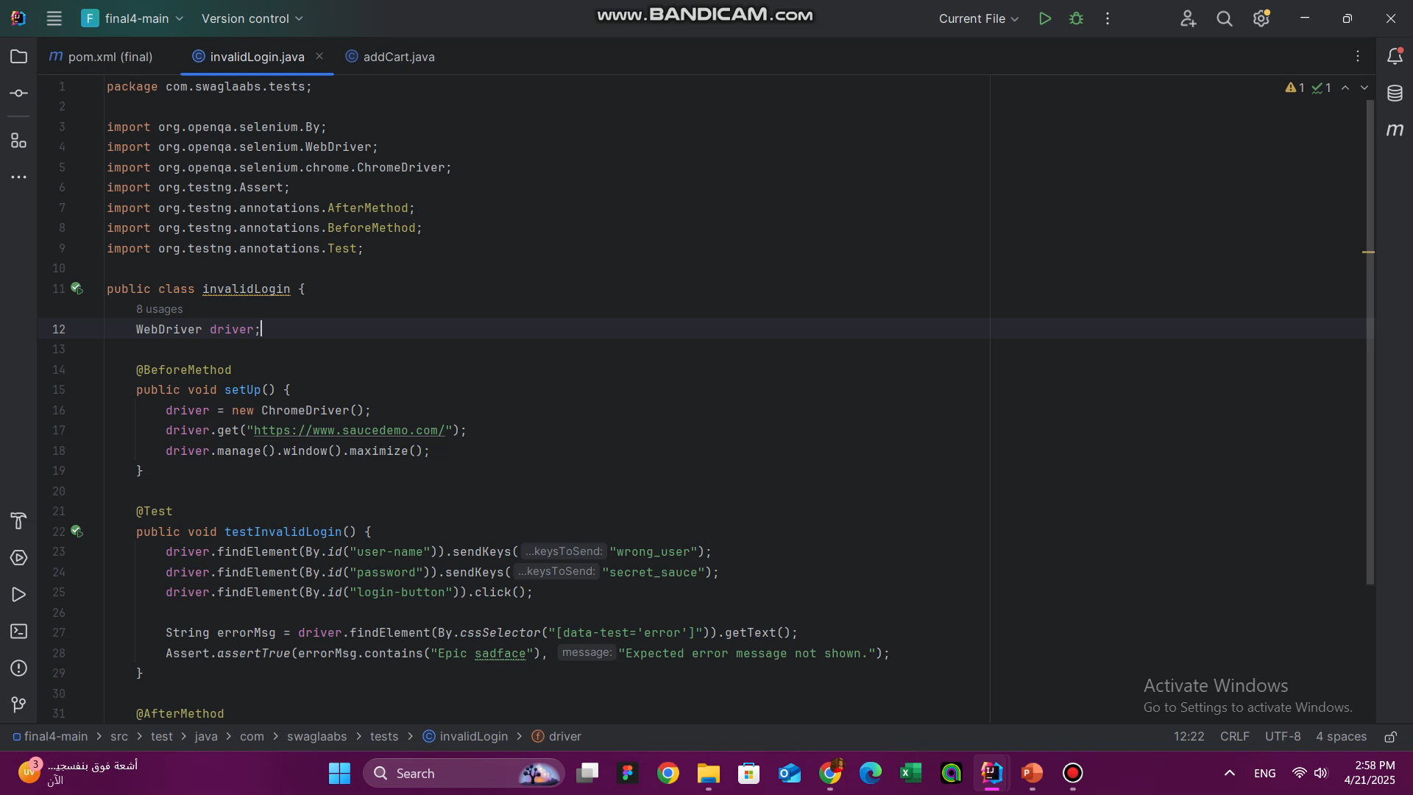
The Demo

Slide 14
GitHub Repo
https://github.com/Nada-Disouky/SWAGLAB

Slide 15
Conclusion
In our SWAG Labs Test Automation Project, we focused on automating the login and add-to-cart functionalities using Selenium. Automating these key actions allowed us to speed up testing, reduce manual errors, and ensure more consistent results. This approach improved the efficiency of our testing process and helped us deliver reliable outcomes, ultimately contributing to faster and more effective software quality assurance.

Slide 16
Reference
1. Selenium Official Documentation. Available at: https://www.selenium.dev/documentation/en/
2. Guru99 Automation Testing Guide. Available at: https://www.guru99.com/automation-testing.html
3. Software Testing Help - Selenium Tutorials. Available at: https://www.softwaretestinghelp.com/selenium-tutorial-1/
4. "Test Automation Best Practices" by Ministry of Testing. Available at: https://www.ministryoftesting.com/

